Slide 1
HIGH-PERFORMANCE NETWORKING
:: USER-LEVEL NETWORKING
:: REMOTE DIRECT MEMORY ACCESS
CS6410
Moontae Lee (Nov 20, 2014) Part 1

Slide 2
Overview
00
◻◻ Background
◻◻ User-level Networking (U-Net)
◻◻ Remote Direct Memory Access (RDMA)
◻◻ Performance

Slide 3
Index
00
Background

Slide 4
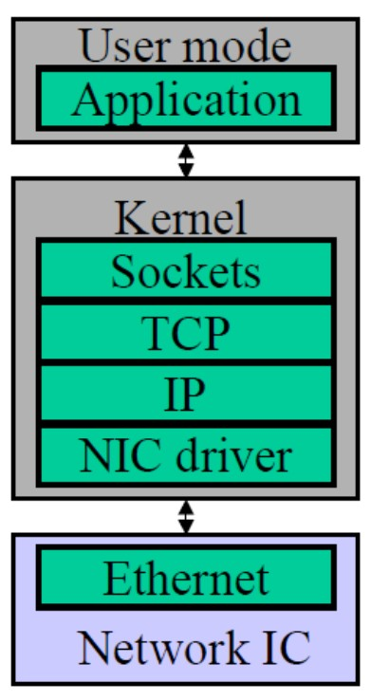
Network Communication
01
◻◻ Send
 Application buffer →→ Socket buffer
 Attach headers
 Data is pushed to NIC buffer
◻◻ Receive
 NIC buffer →→ Socket buffer
 Parsing headers
 Data is copied into Application buffer
 Application is scheduled (context switching)

Slide 5
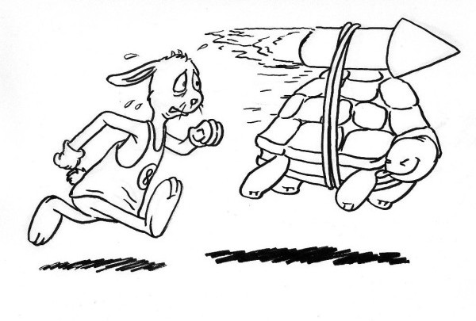
Today’s Theme
02
Faster and lightweight communication!

Slide 6
Terms and Problems
03
◻◻ Communication latency
 Processing overhead: message-handling time at sending/receiving ends
 Network latency: message transmission time between two ends (i.e., end-to-end latency)

Slide 7
Terms and Problems
03
◻◻ Communication latency
 Processing overhead: message-handling time at sending/receiving ends
 Network latency: message transmission time between two ends (i.e., end-to-end latency)
◻◻ If network environment satisfies
 High bandwidth / Low network latency
 Long connection durations / Relatively few connections

Slide 8
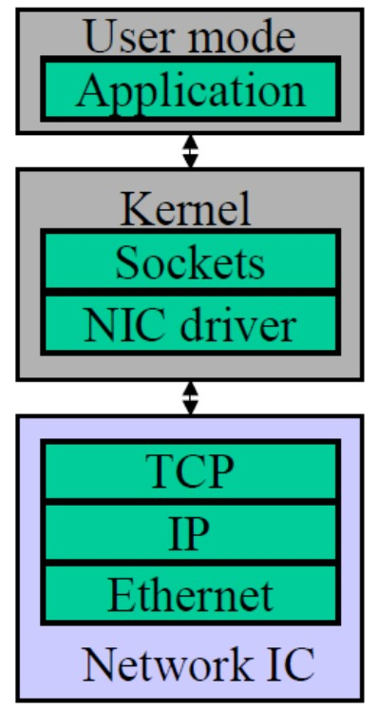
TCP Offloading Engine (TOE)
04
THIS IS NOT OUR STORY!

Slide 9
Our Story
05
◻◻ Large vs Small messages
 Large: transmission dominant →→ new networks improves (e.g., video/audio stream)
 Small: processing dominant →→ new paradigm improves (e.g., just a few hundred bytes)

Slide 10
Our Story
05
◻◻ Large vs Small messages
 Large: transmission dominant →→ new networks improves (e.g., video/audio stream)
 Small: processing dominant →→ new paradigm improves (e.g., just a few hundred bytes)
◻◻ Our underlying picture
 Sending many small messages in LAN
 Processing overhead is overwhelming
(e.g., buffer management, message copies, interrupt)

Slide 11

Traditional Architecture
06
◻◻ Problem: Messages pass through the kernel
 Low performance
 Duplicate several copies
 Multiple abstractions between device driver and user apps
 Low flexibility
 All protocol processing inside the kernel
 Hard to support new protocols and new message send/receive interfaces

Slide 12
History of High-Performance
07
◻◻ User-level Networking (U-Net)
 One of the first kernel-bypassing systems
◻◻ Virtual Interface Architecture (VIA)
 First attempt to standardize user-level communication
 Combine U-Net interface with remote DMA service
◻◻ Remote Direct Memory Access (RDMA)
 Modern high-performance networking
 Many other names, but sharing common themes

Slide 13
Index
00
U-Net

Slide 14
U-Net Ideas and Goals
08
◻◻ Move protocol processing parts into user space!
 Move the entire protocol stack to user space
 Remove kernel completely from data communication path

Slide 15
U-Net Ideas and Goals
08
◻◻ Move protocol processing parts into user space!
 Move the entire protocol stack to user space
 Remove kernel completely from data communication path
◻◻ Focusing on small messages, key goals are:
 High performance / High flexibility

Slide 16
U-Net Ideas and Goals
08
◻◻ Move protocol processing parts into user space!
 Move the entire protocol stack to user space
 Remove kernel completely from data communication path
◻◻ Focusing on small messages, key goals are:
 High performance / High flexibility
 Low communication latency in local area setting
 Exploit full bandwidth
 Emphasis on protocol design and integration flexibility
 Portable to off-the-shelf communication hardware

Slide 17
U-Net Ideas and Goals
08
◻◻ Move protocol processing parts into user space!
 Move the entire protocol stack to user space
 Remove kernel completely from data communication path
◻◻ Focusing on small messages, key goals are:
 High performance / High flexibility
 Low communication latency in local area setting
 Exploit full bandwidth
 Emphasis on protocol design and integration flexibility
 Portable to off-the-shelf communication hardware

Slide 18
U-Net Ideas and Goals
08
◻◻ Move protocol processing parts into user space!
 Move the entire protocol stack to user space
 Remove kernel completely from data communication path
◻◻ Focusing on small messages, key goals are:
 High performance / High flexibility
 Low communication latency in local area setting
 Exploit full bandwidth
 Emphasis on protocol design and integration flexibility
 Portable to off-the-shelf communication hardware

Slide 19
U-Net Ideas and Goals
08
◻◻ Move protocol processing parts into user space!
 Move the entire protocol stack to user space
 Remove kernel completely from data communication path
◻◻ Focusing on small messages, key goals are:
 High performance / High flexibility
 Low communication latency in local area setting
 Exploit full bandwidth
 Emphasis on protocol design and integration flexibility
 Portable to off-the-shelf communication hardware

Slide 20
U-Net Ideas and Goals
08
◻◻ Move protocol processing parts into user space!
 Move the entire protocol stack to user space
 Remove kernel completely from data communication path
◻◻ Focusing on small messages, key goals are:
 High performance / High flexibility
 Low communication latency in local area setting
 Exploit full bandwidth
 Emphasis on protocol design and integration flexibility
 Portable to off-the-shelf communication hardware

Slide 21
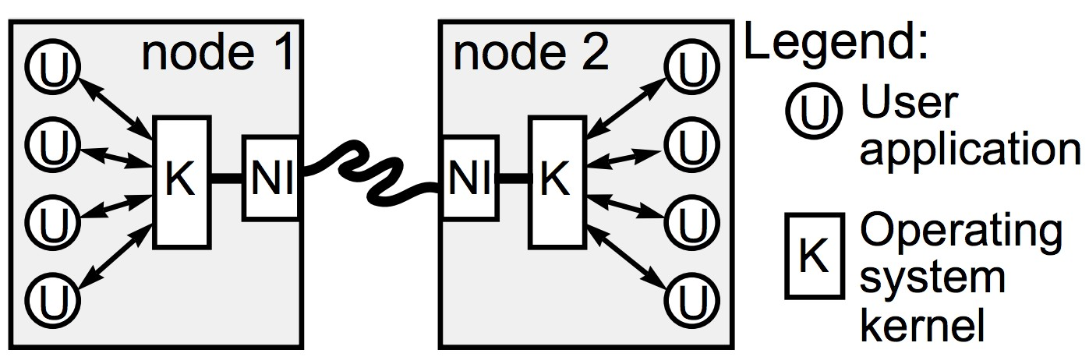
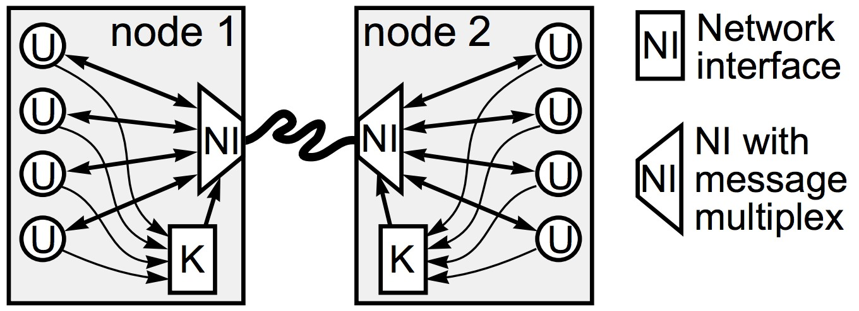
U-Net Architecture
09
◻◻ Traditionally
 Kernel controls network
 All communications via the kernel
◻◻ U-Net
 Applications can access network directly via MUX
 Kernel involves only in connection setup
* Virtualize NI →→ provides each process the illusion of owning interface to network

Slide 22
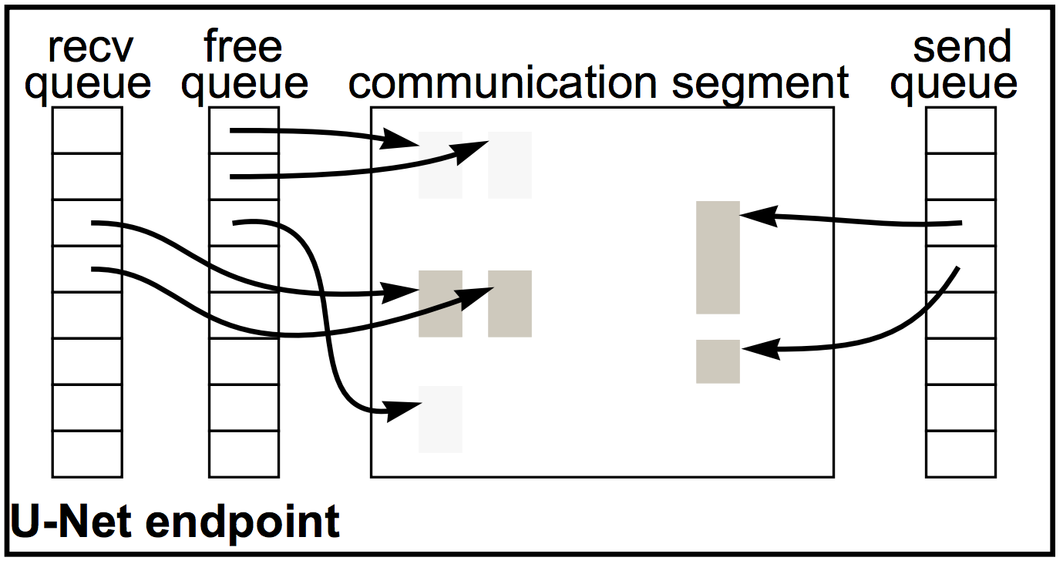
U-Net Building Blocks
10
◻◻ End points: application’s / kernel’s handle into network
◻◻ Communication segments: memory buffers for sending/receiving messages data
◻◻ Message queues: hold descriptors for messages that are to be sent or have been received

Slide 23
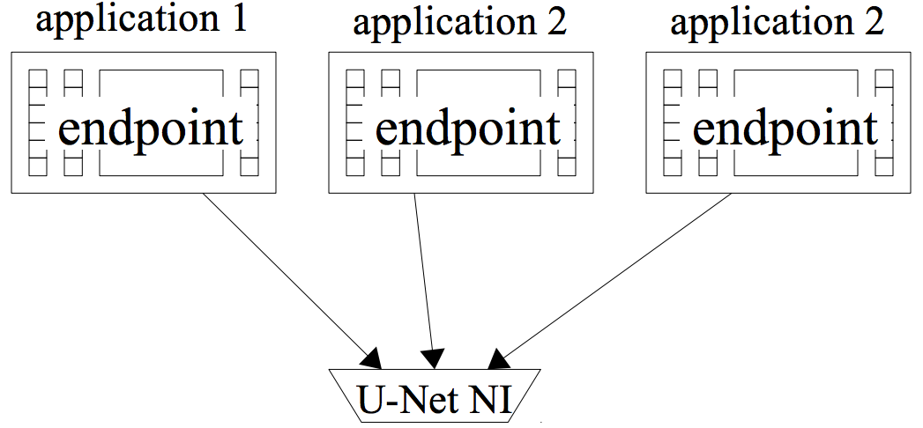
U-Net Communication: Initialize
11
◻◻ Initialization:
 Create single/multiple endpoints for each application
 Associate a communication segment and send/receive/free message queues with each endpoint

Slide 24
U-Net Communication: Send
12
START
Composes the data in the communication segment
[NI] exerts back- pressure to the user processes
Associated send buffer can be reused
Push a descriptor for the message onto the send queue
[NI] indicates messages injection status by flag
Is Queue Full?
[NI] leaves the
◻◻ descriptor in the
queue
Backed- up?
[NI] picks up the message and inserts into the network
NEGATIVE
POSITIVE
Send as simple as changing one or two pointers!

Slide 25
U-Net Communication: Receive
13
START
[NI] demultiplexes incoming messages to their destinations
Read the data using the descriptor from the receive queue
Periodically check the status of queue
polling
◻◻
Get available space from the free queue
Receive Model?
event driven
Use upcall to signal the arrival
Transfer data into the appropriate comm. segment
Push message descriptor to the receive queue
Receive as simple as NIC changing one or two pointers!

Slide 26
U-Net Protection
14
◻◻ Owning process protection
 Endpoints
 Communication segments
 Send/Receive/Free queues
Only owning process can access!
◻◻ Tag protection
 Outgoing messages are tagged with the originating endpoint address
 Incoming messages are only delivered to the correct destination endpoint

Slide 27
U-Net Zero Copy
15
◻◻ Base-level U-Net (might not be ‘zero’ copy)
 Send/receive needs a buffer
 Requires a copy between application data structures and the buffer in the communication segment
 Can also keep the application data structures in the buffer without requiring a copy
◻◻ Direct Access U-Net (true ‘zero’ copy)
 Span the entire process address space
 But requires special hardware support to check address

Slide 28
Index
00
RDMA

Slide 29
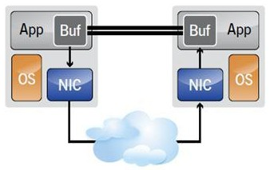
RDMA Ideas and Goals
16
◻◻ Move buffers between two applications via network
◻◻ Once programs implement RDMA:
 Tries to achieve lowest latency and highest throughput
 Smallest CPU footprint

Slide 30
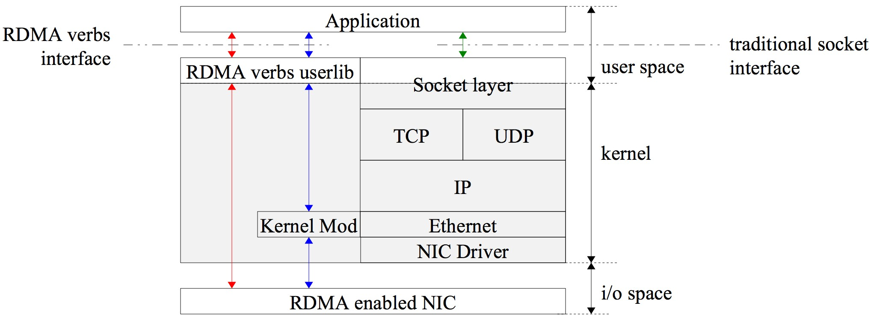
RDMA Architecture (1/2)
17
 Traditionally, socket interface involves the kernel
 Has a dedicated verbs interface instead of the socket interface
 Involves the kernel only on control path
 Can access rNIC directly from user space on data path bypassing kernel

Slide 31
RDMA Architecture (2/2)
18
 To initiate RDMA, establish data path from RNIC to application memory
 Verbs interface provide API to establish these data path
 Once data path is established, directly read from/write to buffers
 Verbs interface is different from the traditional socket interface.

Slide 32
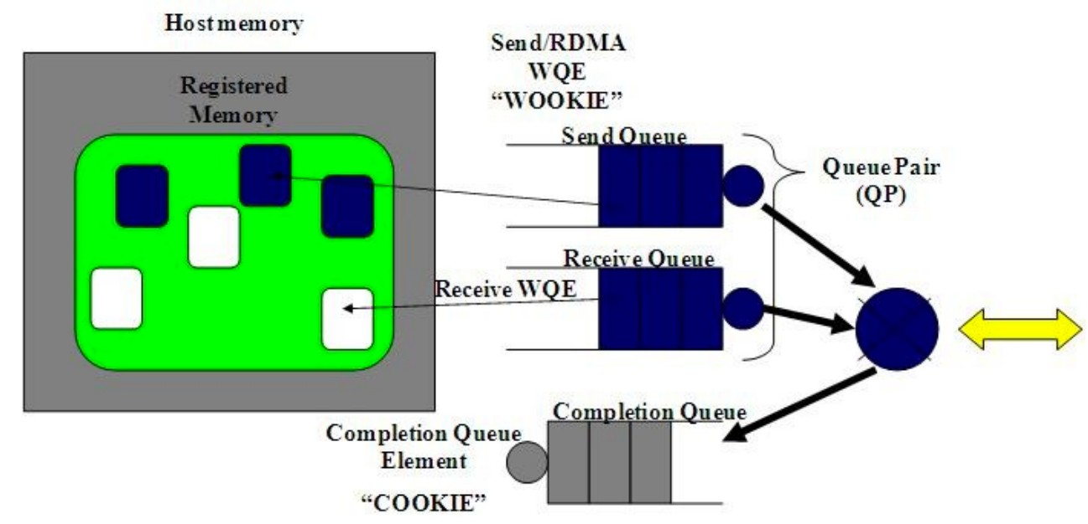
RDMA Building Blocks
19
◻◻ Applications use verb interfaces in order to
 Register memory: kernel ensures memory is pinned and accessible by DMA
 Create a queue pair (QP): a pair of send/receive queues
 Create a completion queue (CQ): RNIC puts a new completion-queue element into the CQ after an operation has completed.
 Send/receive data

Slide 33
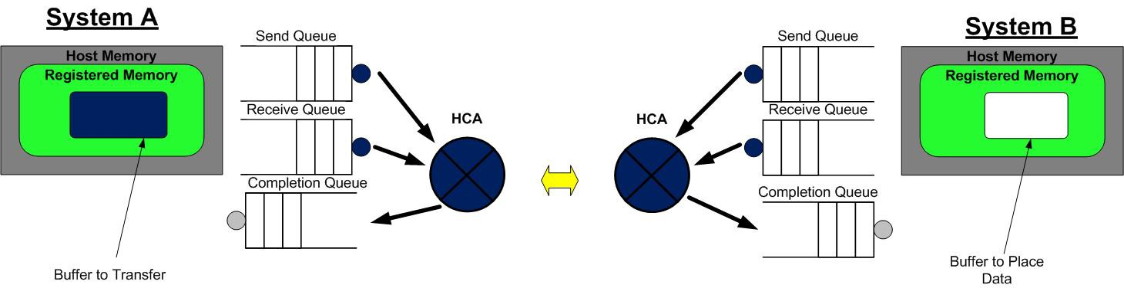
RDMA Communication (1/4)
20
◻◻ Step 1

Slide 34
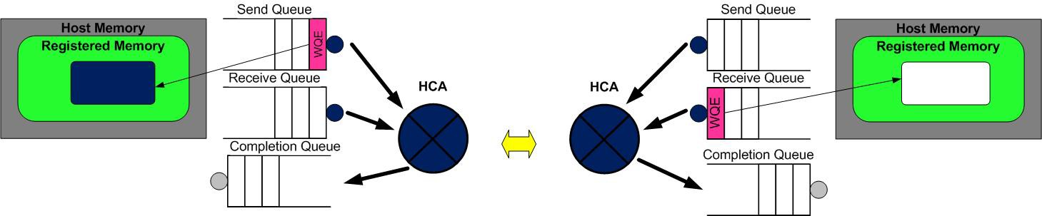
RDMA Communication (2/4)
21
◻◻ Step 2

Slide 35
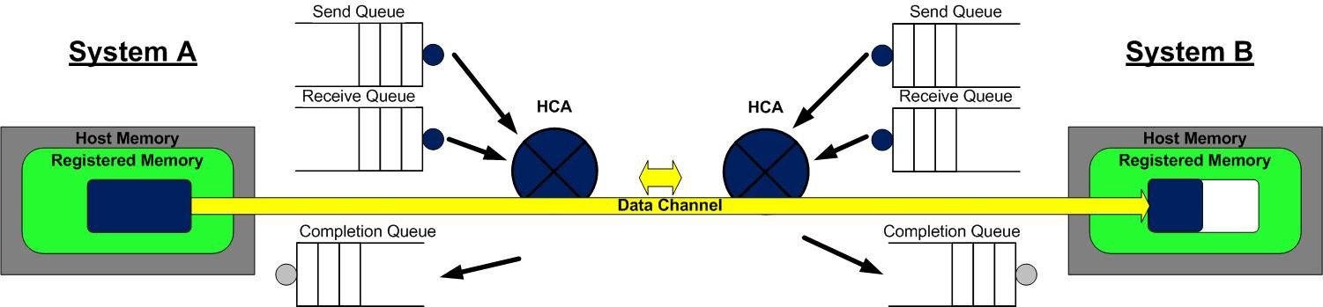
RDMA Communication (3/4)
22
◻◻ Step 3

Slide 36
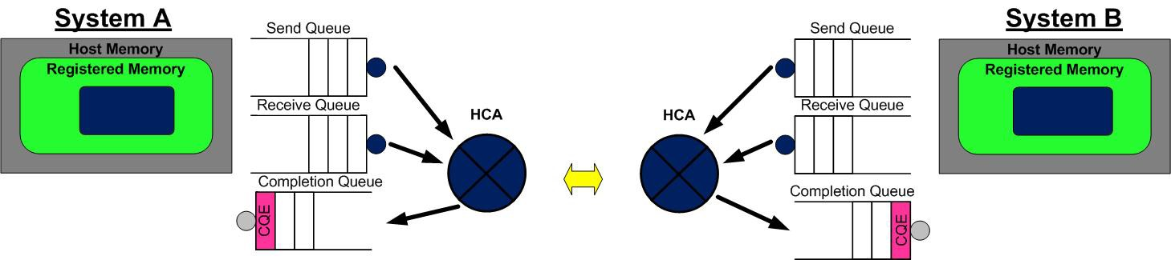
RDMA Communication (4/4)
23
◻◻ Step 4

Slide 37
Index
00
Performance

Slide 38
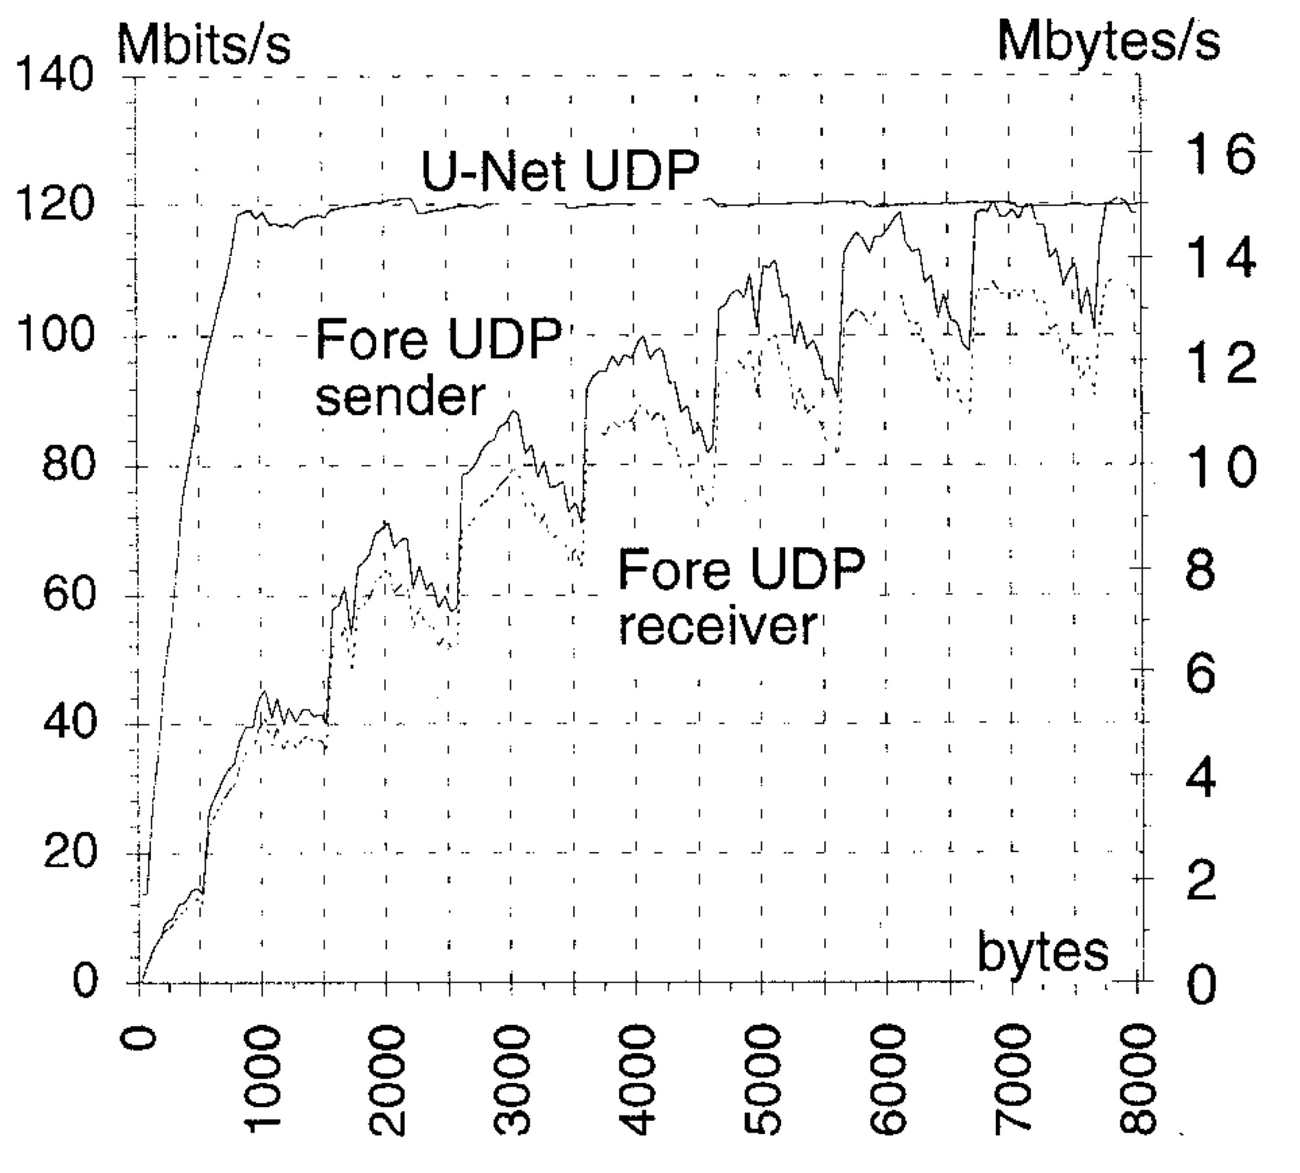
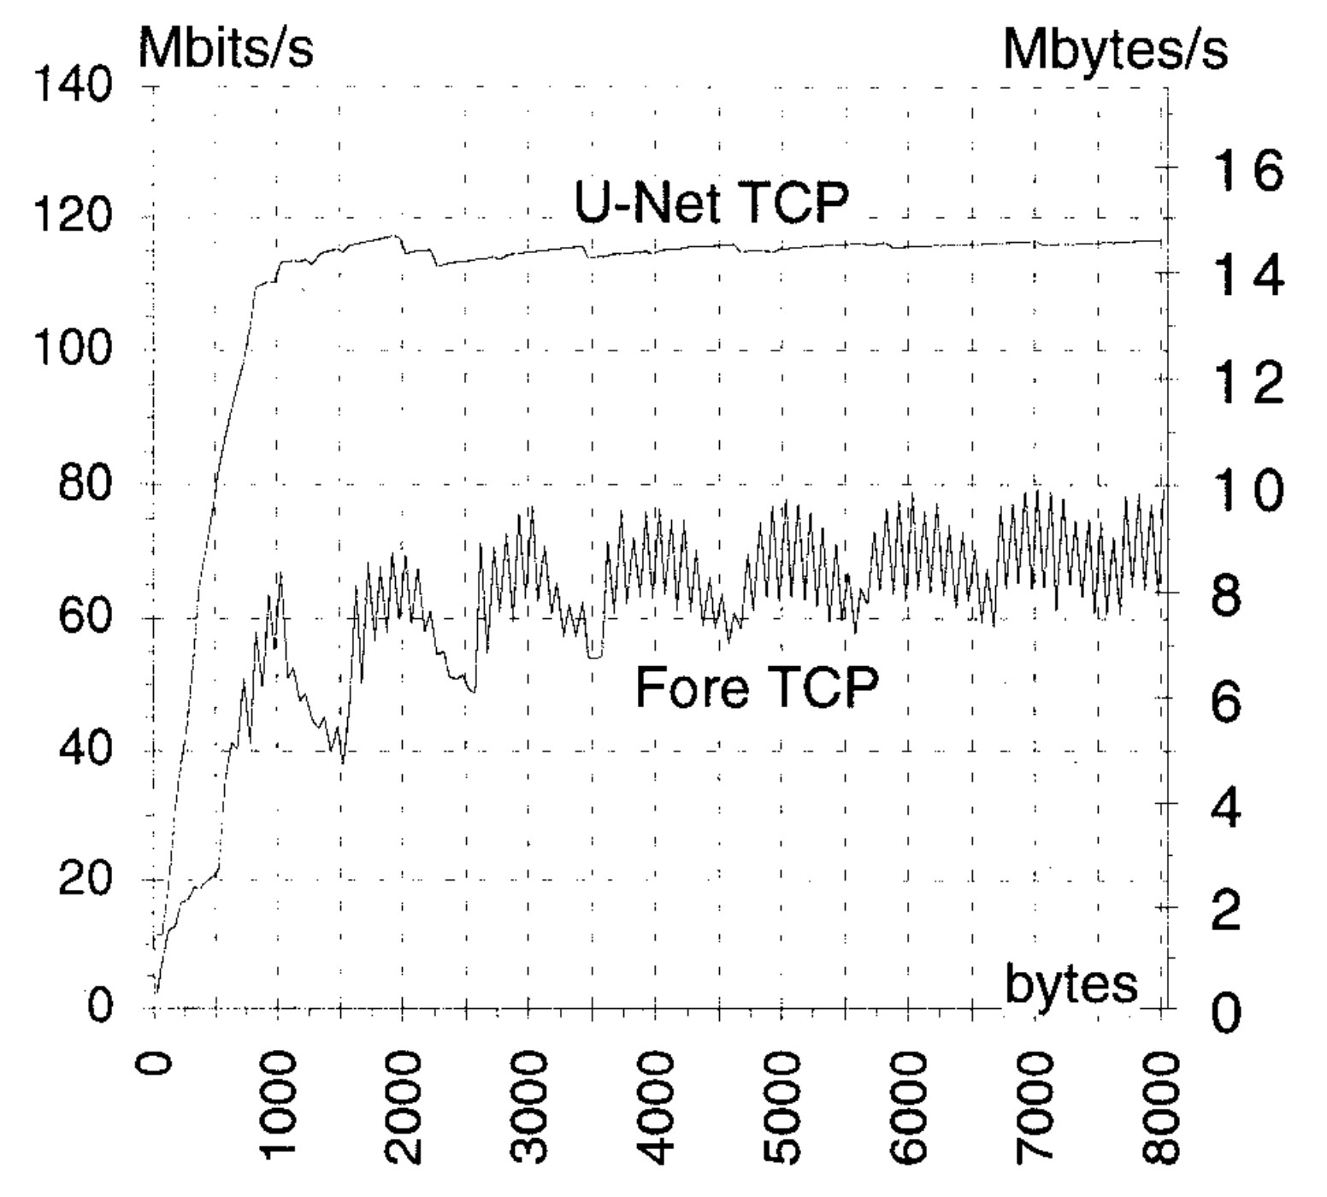
U-Net Performance: Bandwidth
24
* UDP bandwidth
* TCP bandwidth
size of messages
data generation by application

Slide 39
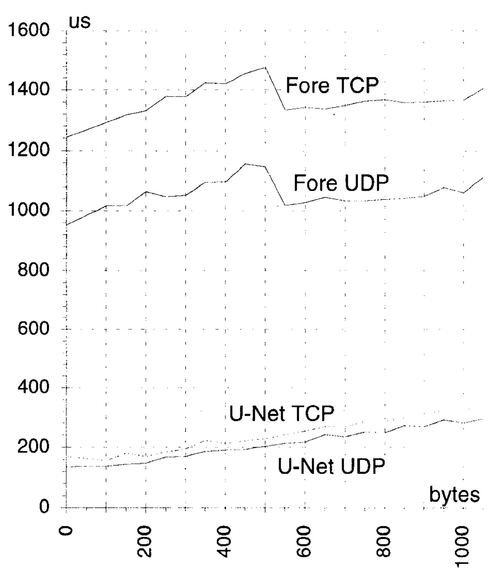
U-Net Performance: Latency
25
◻◻ End-to-end round trip latency
size of messages

Slide 40
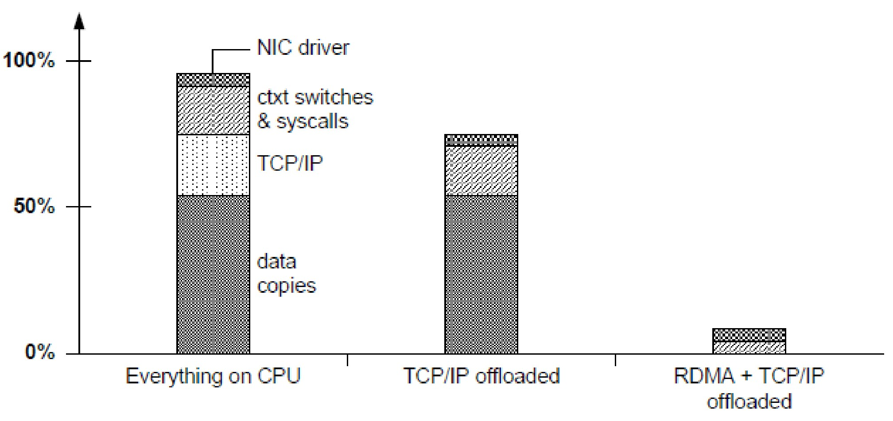
RDMA Performance: CPU load
26
◻◻ CPU Load

Slide 41
Modern RDMA
Several major vendors: Qlogic (Infiniband), Mellanox, Intel, Chelsio, others
RDMA has evolved from the U/Net approach to have three “modes”
Infiniband (Qlogic PSM API): one-sided, no “connection setup”
More standard: “qpair” on each side, plus a binding mechanism (one queue is for the sends, or receives, and the other is for sensing completions)
One-sided RDMA: after some setup, allows one side to read or write to the memory managed by the other side, but pre-permission is required
RDMA + VLAN: needed in data centers with multitenancy

Slide 42
Modern RDMA
Memory management is tricky:
Pages must be pinned and mapped into IOMMU
Kernel will zero pages on first allocation request: slow
If a page is a mapped region from a file, kernel may try to automatically issue a disk write after updates, costly
Integration with modern NVRAM storage is “awkward”
On multicore NUMA machines, hard to know which core owns a particular memory page, yet this matters
Main reason we should care?
RDMA runs at 20, 40Gb/s. And soon 100, 200… 1Tb/s
But memcpy and memset run at perhaps 30Gb/s

Slide 43
SoftROCE
Useful new option
With standard RDMA may people worry programs won’t be portable and will run only with one kind of hardware
SoftROCE allows use of the RDMA software stack (libibverbs.dll) but tunnels via TCP hence doesn’t use hardware RDMA at all
Zero-copy sends, but needs one-copy for receives
Intel iWarp is aimed at something similar
Tries to offer RDMA with zero-copy on both sides under the TCP API by dropping TCP into the NIC
Requires a special NIC with an RDMA chip-set

Slide 44
HIGH-PERFORMANCE NETWORKING
:: USER-LEVEL NETWORKING
:: REMOTE DIRECT MEMORY ACCESS
CS6410
Jaeyong Sung (Nov 20, 2014)
Part 2

Slide 45
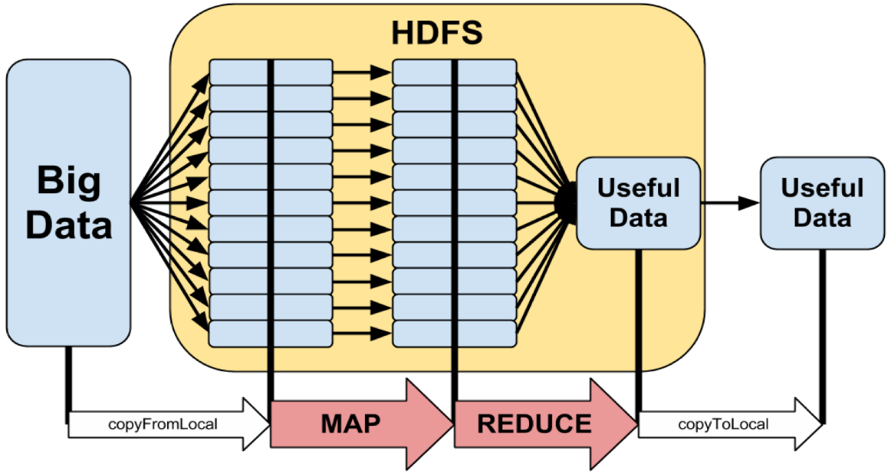
Hadoop
2
Big Data
very common in industries
e.g. Facebook, Google, Amazon, …
Hadoop
open source MapReduce for handling large data
require lots of data transfers

Slide 46
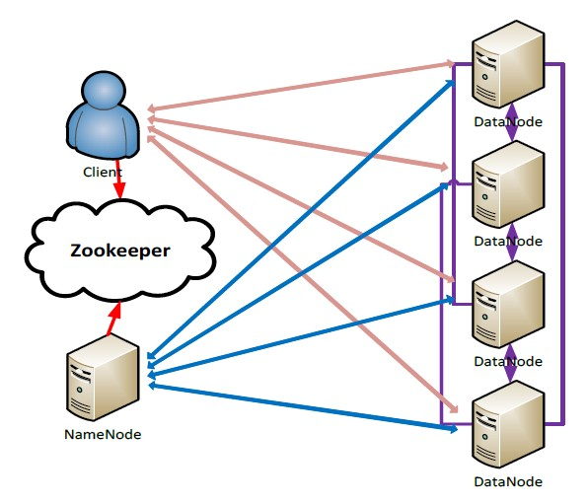
Hadoop Distributed File System
3
primary storage for Hadoop clusters
both Hadoop MapReduce and HBase rely on it
communication intensive middleware
layered on top of TCP/IP

Slide 47
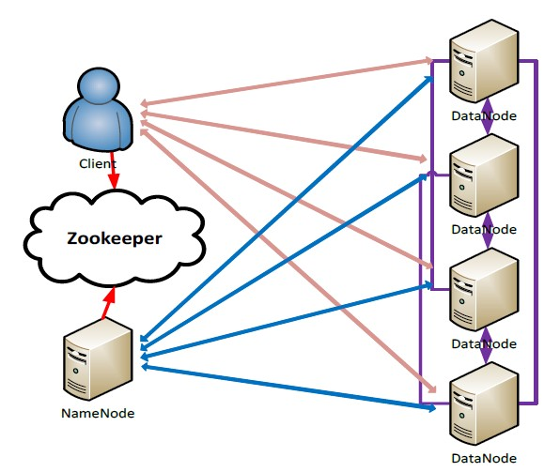
Hadoop Distributed File System
4
highly reliable fault-tolerant replications
in data-intensive applications, network performance becomes key component
HDFS write:
replication

Slide 48
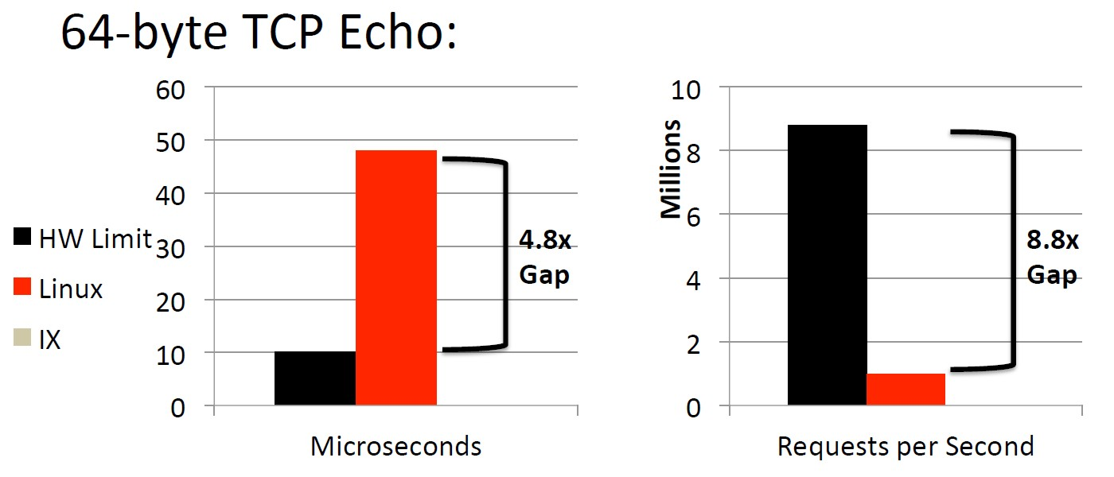
Software Bottleneck
5
Using TCP/IP on Linux,
  TCP echo

Slide 49
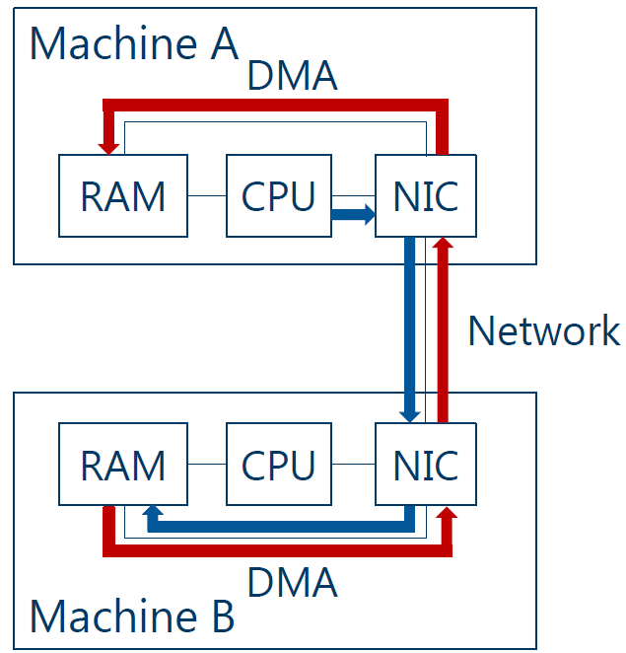
RDMA for HDFS
6
data structure for Hadoop
<key, value> pairs
stored in data blocks of
HDFS
Both write(replication) and read can take advantage of RDMA

Slide 50
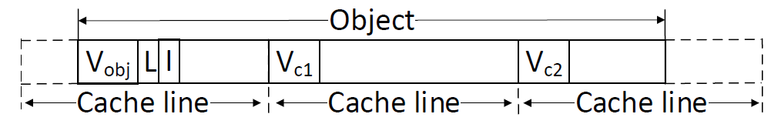
FaRM: Fast Remote Memory
7
relies on cache coherent DMA
object’s version number
stored both in the first word of the object header and at the start of each cache line
NOT visible to the application (e.g. HDFS)

Slide 51
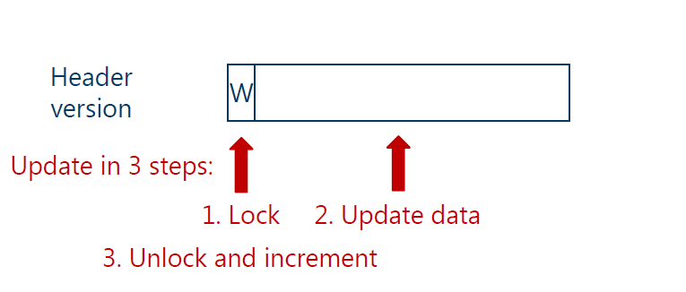
Traditional Lock-free reads
8
For updating the data,

Slide 52
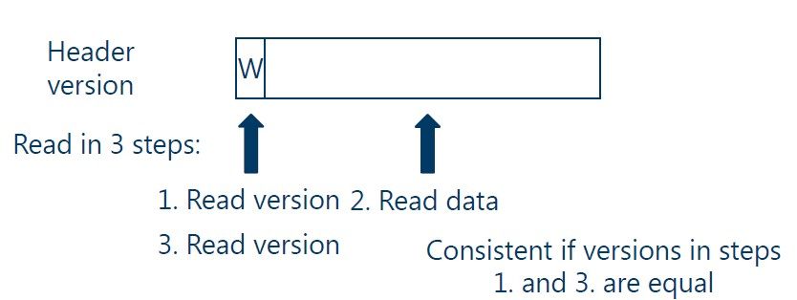
Traditional Lock-free reads
9
Reading requires three accesses

Slide 53
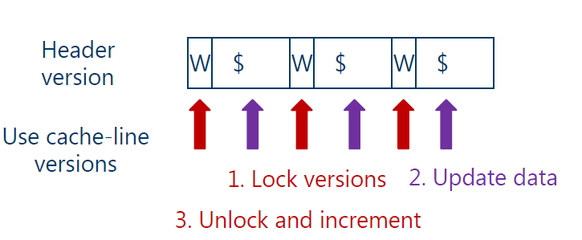
FaRM Lock-free Reads
10
FaRM relies on cache coherent DMA
Version info in each of cache-lines

Slide 54
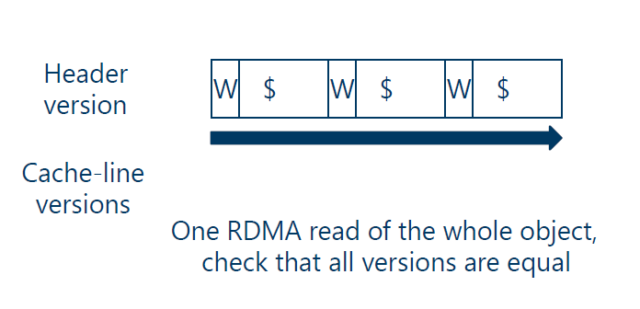
FaRM Lock-free Reads
11
single RDMA read

Slide 55
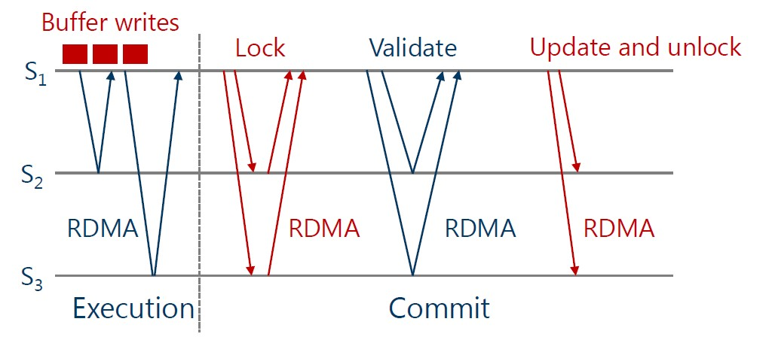
FaRM: Distributed Transactions
12
general mechanism to ensure consistency
Two-stage commits
(checks version number)

Slide 56
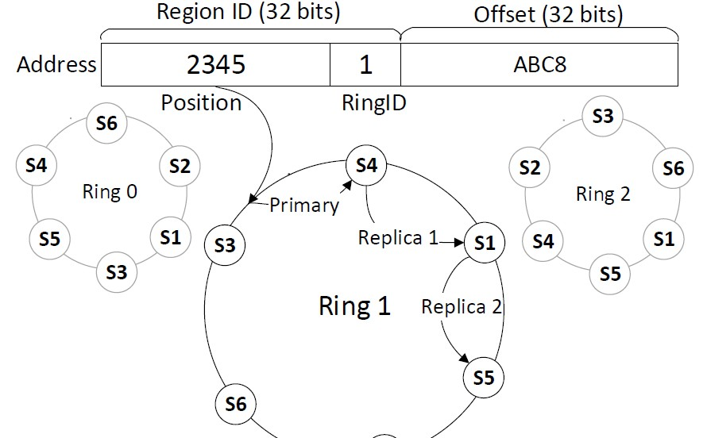
Shared Address Space
13
shared address space consists of many shared
memory regions
consistent hashing for mapping region identifier to
the machine that stores the object
  each machine is mapped into k virtual rings

Slide 57
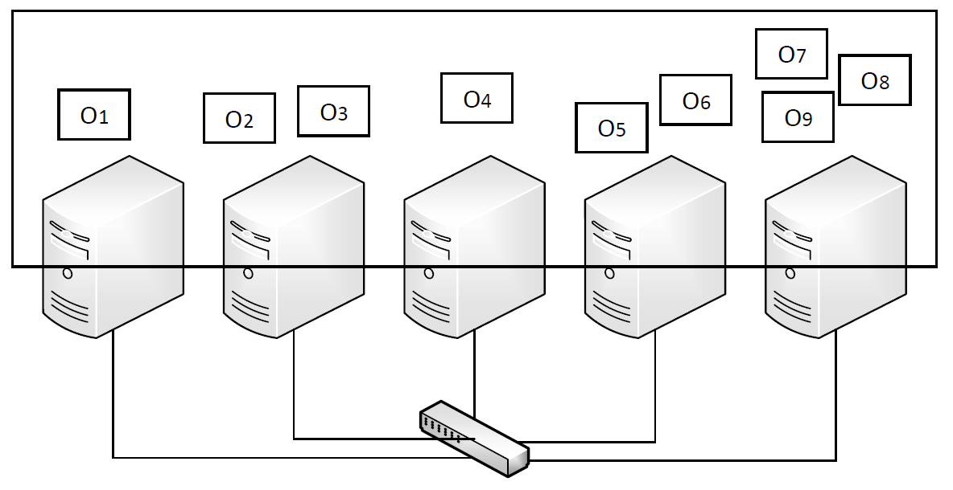
Transactions in Shared Address Space
14
Strong consistency
Atomic execution of multiple operations
Shared Address Space
Read
Write
Alloc
Read
Write
Free

Slide 58
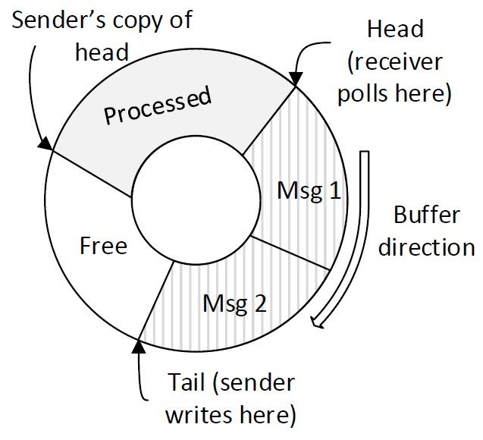
Communication Primitives
15
One-sided RDMA reads
to access data directly
RDMA writes
circular buffer is used for unidirectional channel
one buffer for each
sender/receiver pair
buffer is stored on receiver

Slide 59
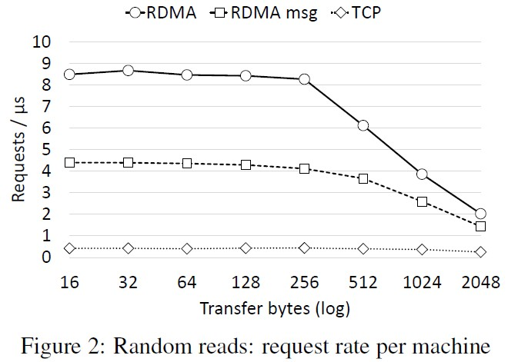
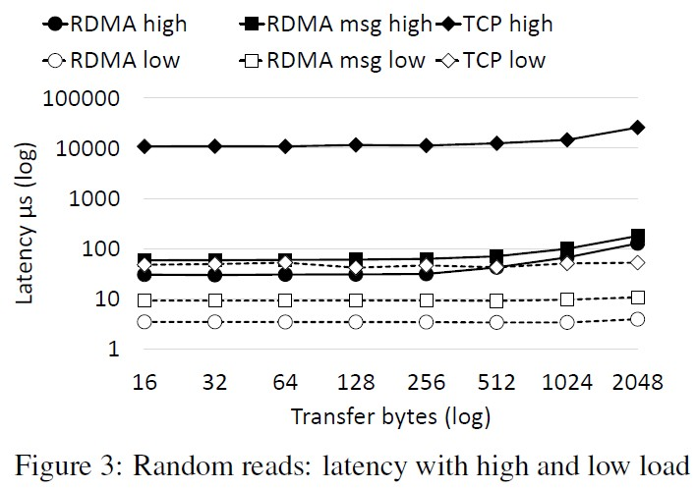
benchmark on communication primitives
16

Slide 60
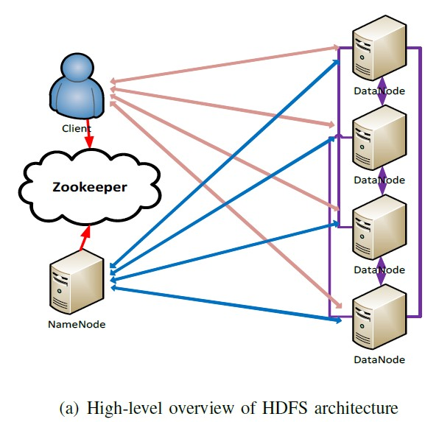
Limited cache space in NIC
17
Some Hadoop clusters can have hundreds and thousands of nodes
Performance of RDMA can suffer as amount of memory registered increases
  NIC will run out of space to cache all page tables

Slide 61
Limited cache space in NIC
18
FaRM’s solution: PhyCo
kernel driver that allocates a large number of physically contiguous and naturally aligned 2GB memory regions at boot time
maps the region into the virtual address space aligned on a 2GB boundary

Slide 62
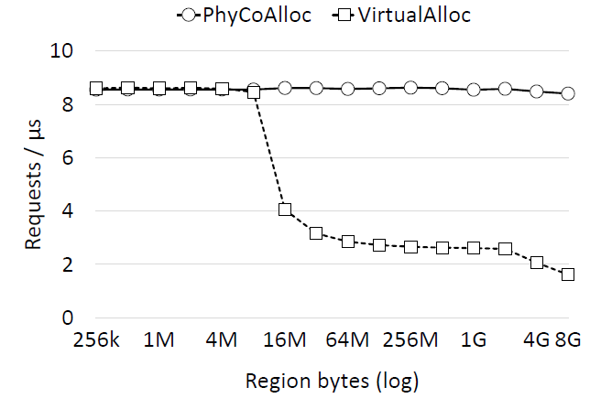
PhyCo
19

Slide 63
Limited cache space in NIC
20
PhyCo still suffered as number of clusters increased
because it can run out of space to cache all queue pair
2 × 𝑚 × 𝑡² queue pairs per machine
𝑚 = number of machines, 𝑡 = number of threads per machine
single connection between a thread and each remote machine
■ 2 × 𝑚 × 𝑡
queue pair sharing among 𝑞 threads
■ 2 × 𝑚 × 𝑡 / 𝑞

Slide 64
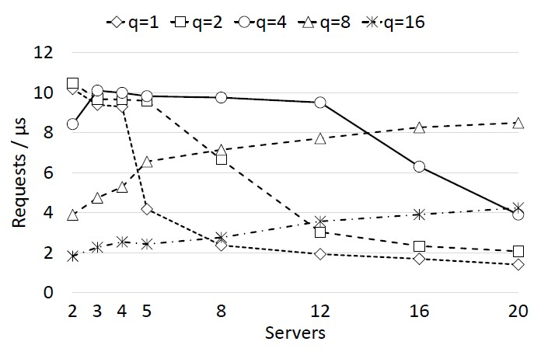
Connection Multiplexing
21
best value of q depends on cluster size

Slide 65
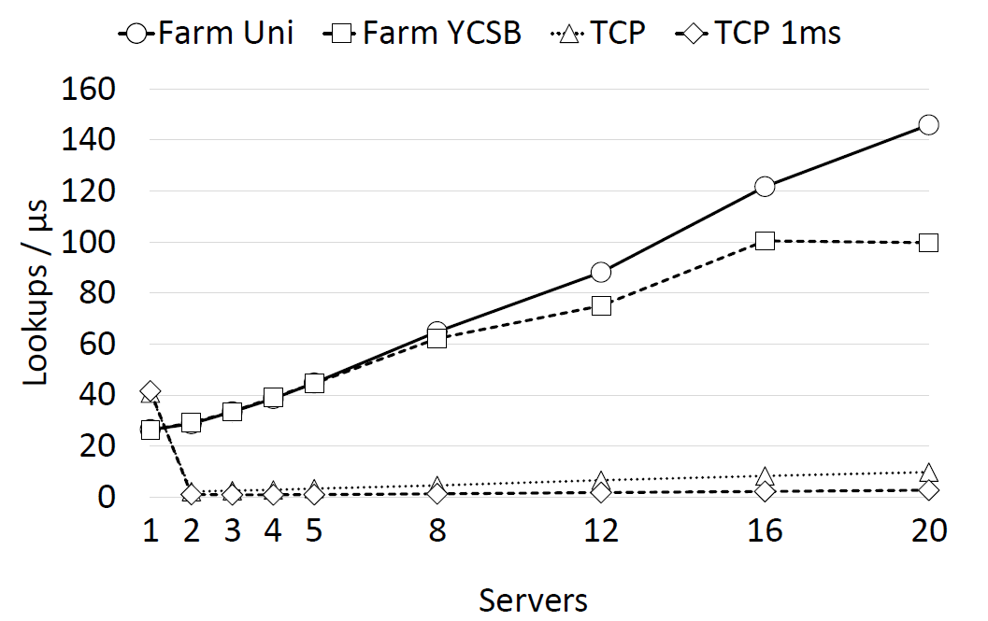
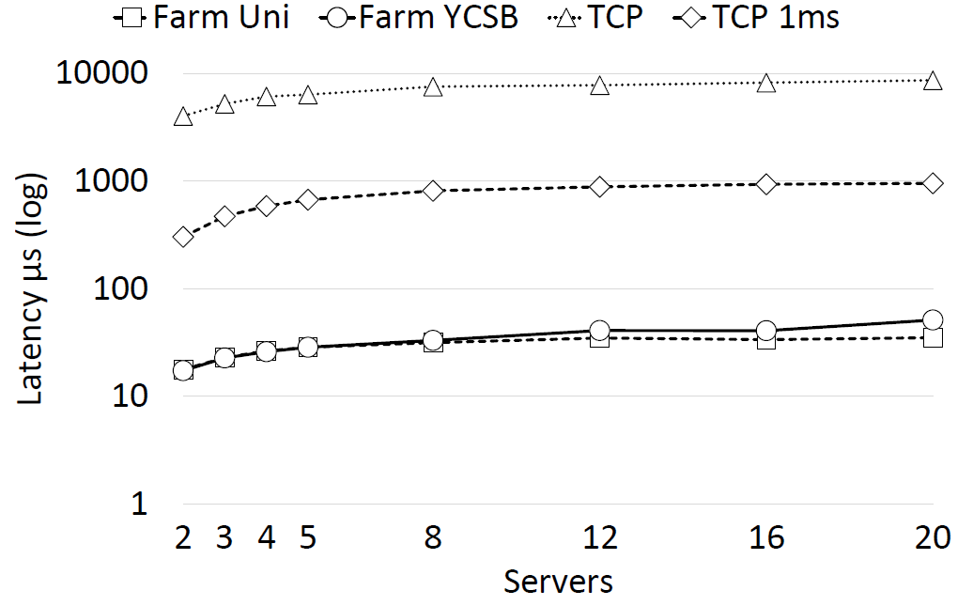
Experiments
22
Key-value store: lookup scalability

Slide 66
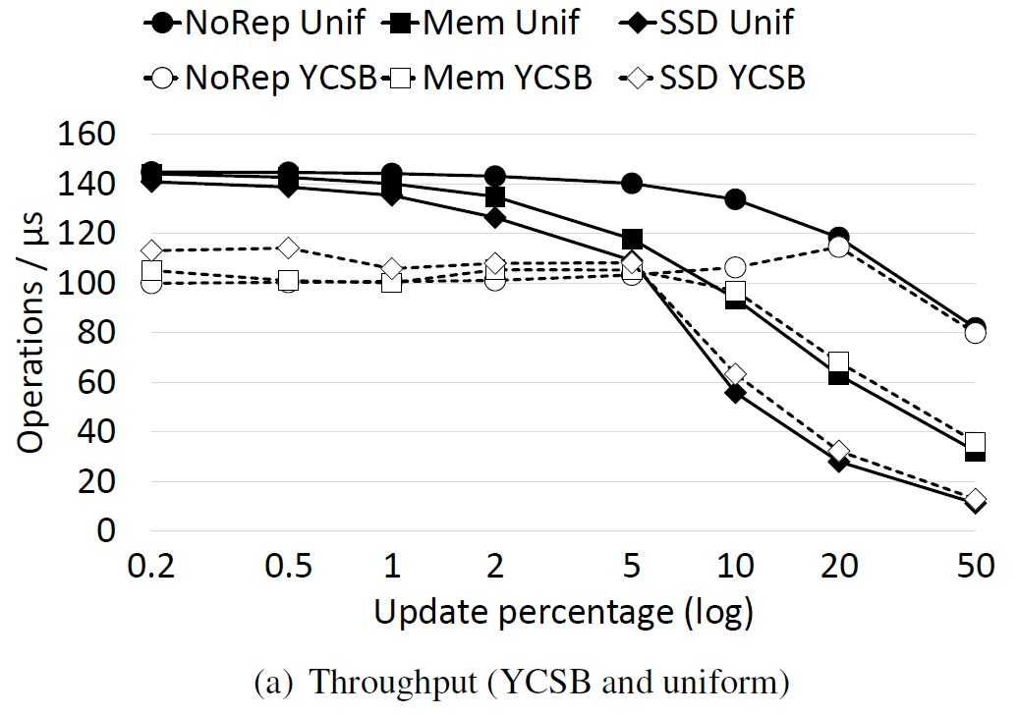
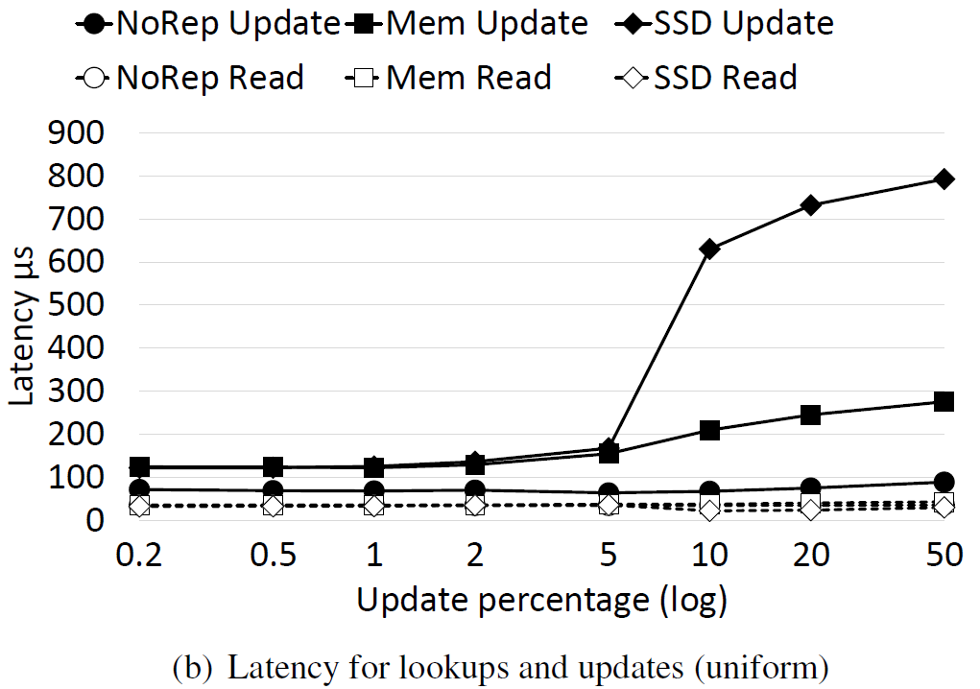
Experiments
23
Key-value store: varying update rates

